Slide 1







Guidelines to Create
Inclusive Classrooms for Neurodiverse Learners
Dr. Ann-Louise Davidson
Concordia University
Dr. Meghrig Terzian
John Abbott College
Monia Poncik
Research Assistant
Concordia University
Alina Gutiérrez
Research Assistant
Concordia University

Slide 2
Agenda
10:00 - About the Project & Methodology
10:05 - What we created
10:10 - Teach With the Brains in Mind
Learning Insights Module
10:15 - Teach With the Brains in Mind
Identifying Cues Module
10:50 - Teach With the Brains in Mind
Support Module
10:55 - Q&A
Notes:
Welcome everyone, and thank you for being here. Today we will explore how neurodivergent students experience the classroom, and how small changes in interpretation and response can significantly shift learning outcomes.

Slide 3

WHY IS THIS RESEARCH IMPORTANT AND RELEVANT?
Neurodivergent Students in Computer Science: Fit with Friction
Notes:
Before we dive into the workshop and resources we created I want to take a moment to explain why this work is important.

Slide 4
Increased Neurodivergent Students
6.7%
11%
Fall 2020
Winter 2025
Many neurodivergent students are naturally drawn to computing and tech-related fields due to their structured, logical, and predictable nature.
The cognitive fit is strong, but social and executive demands may create barriers to success.
Notes:
Many neurodivergent students are naturally drawn to computing and tech-related fields due to their structured, logical, and predictable nature. (Shah et al., 2024)
Structured: programming, data analysis, or systems design involve clear rules, patterns and processes. Neurodivergent students thrive in environments with minimal ambiguity.
Logical: Neurodivergent students excel in logical reasoning and pattern recognition. These skills are highly needed in tech fields, where solving problems is a core part of the work.
Predictable: tech-related tasks often have well-defined problems and outcomes.
The cognitive fit is strong, but social and executive demands may create barriers to success.
Why: increased awareness, improved diagnostic criteria, and more accessible information
Access center: offer accommodations to students who have limitations and/or incapacities resulting from a specific diagnosis and/or medical condition.

Slide 5


Our Research Questions
What can teachers do to help and ease the transition of neurodivergent students from high school to CEGEP?
1
What are the best strategies to help neurodivergent students succeed in computer science?
2
What adjustments can we make to department-led student activities to make them more inclusive?
3

Slide 6
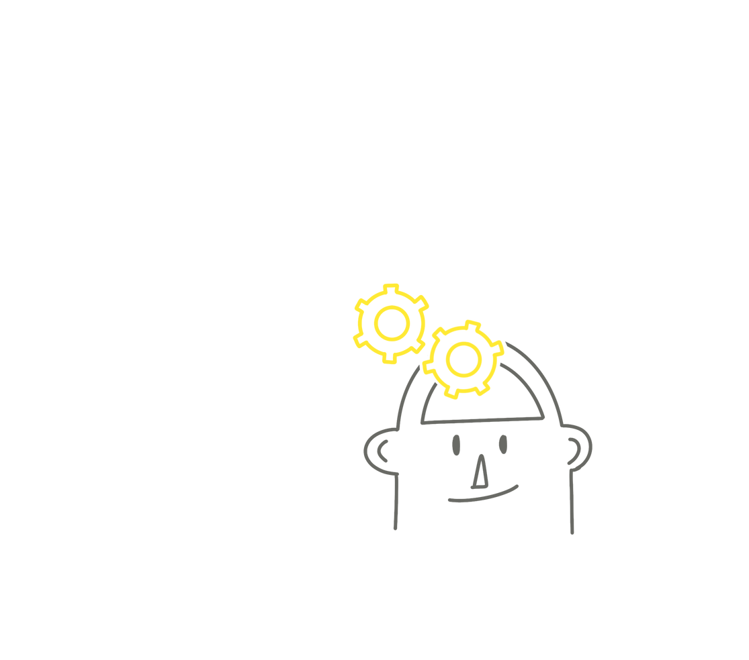
Methodology
Notes:
Before we dive into the workshop and resources we created I want to take a moment to explain why this work is important.

Slide 7
Design-Based Research (DBR)
Student Experience
Learning Science
Computer Science
Neurodivergent Paradigm
Teacher Experience
We used an iterative design process that stayed aligned across students, educators, classrooms, and learning systems.
We worked with educators to co-develop evidence-based insights and proactive strategies that could be applied across different teaching situations.

Slide 8

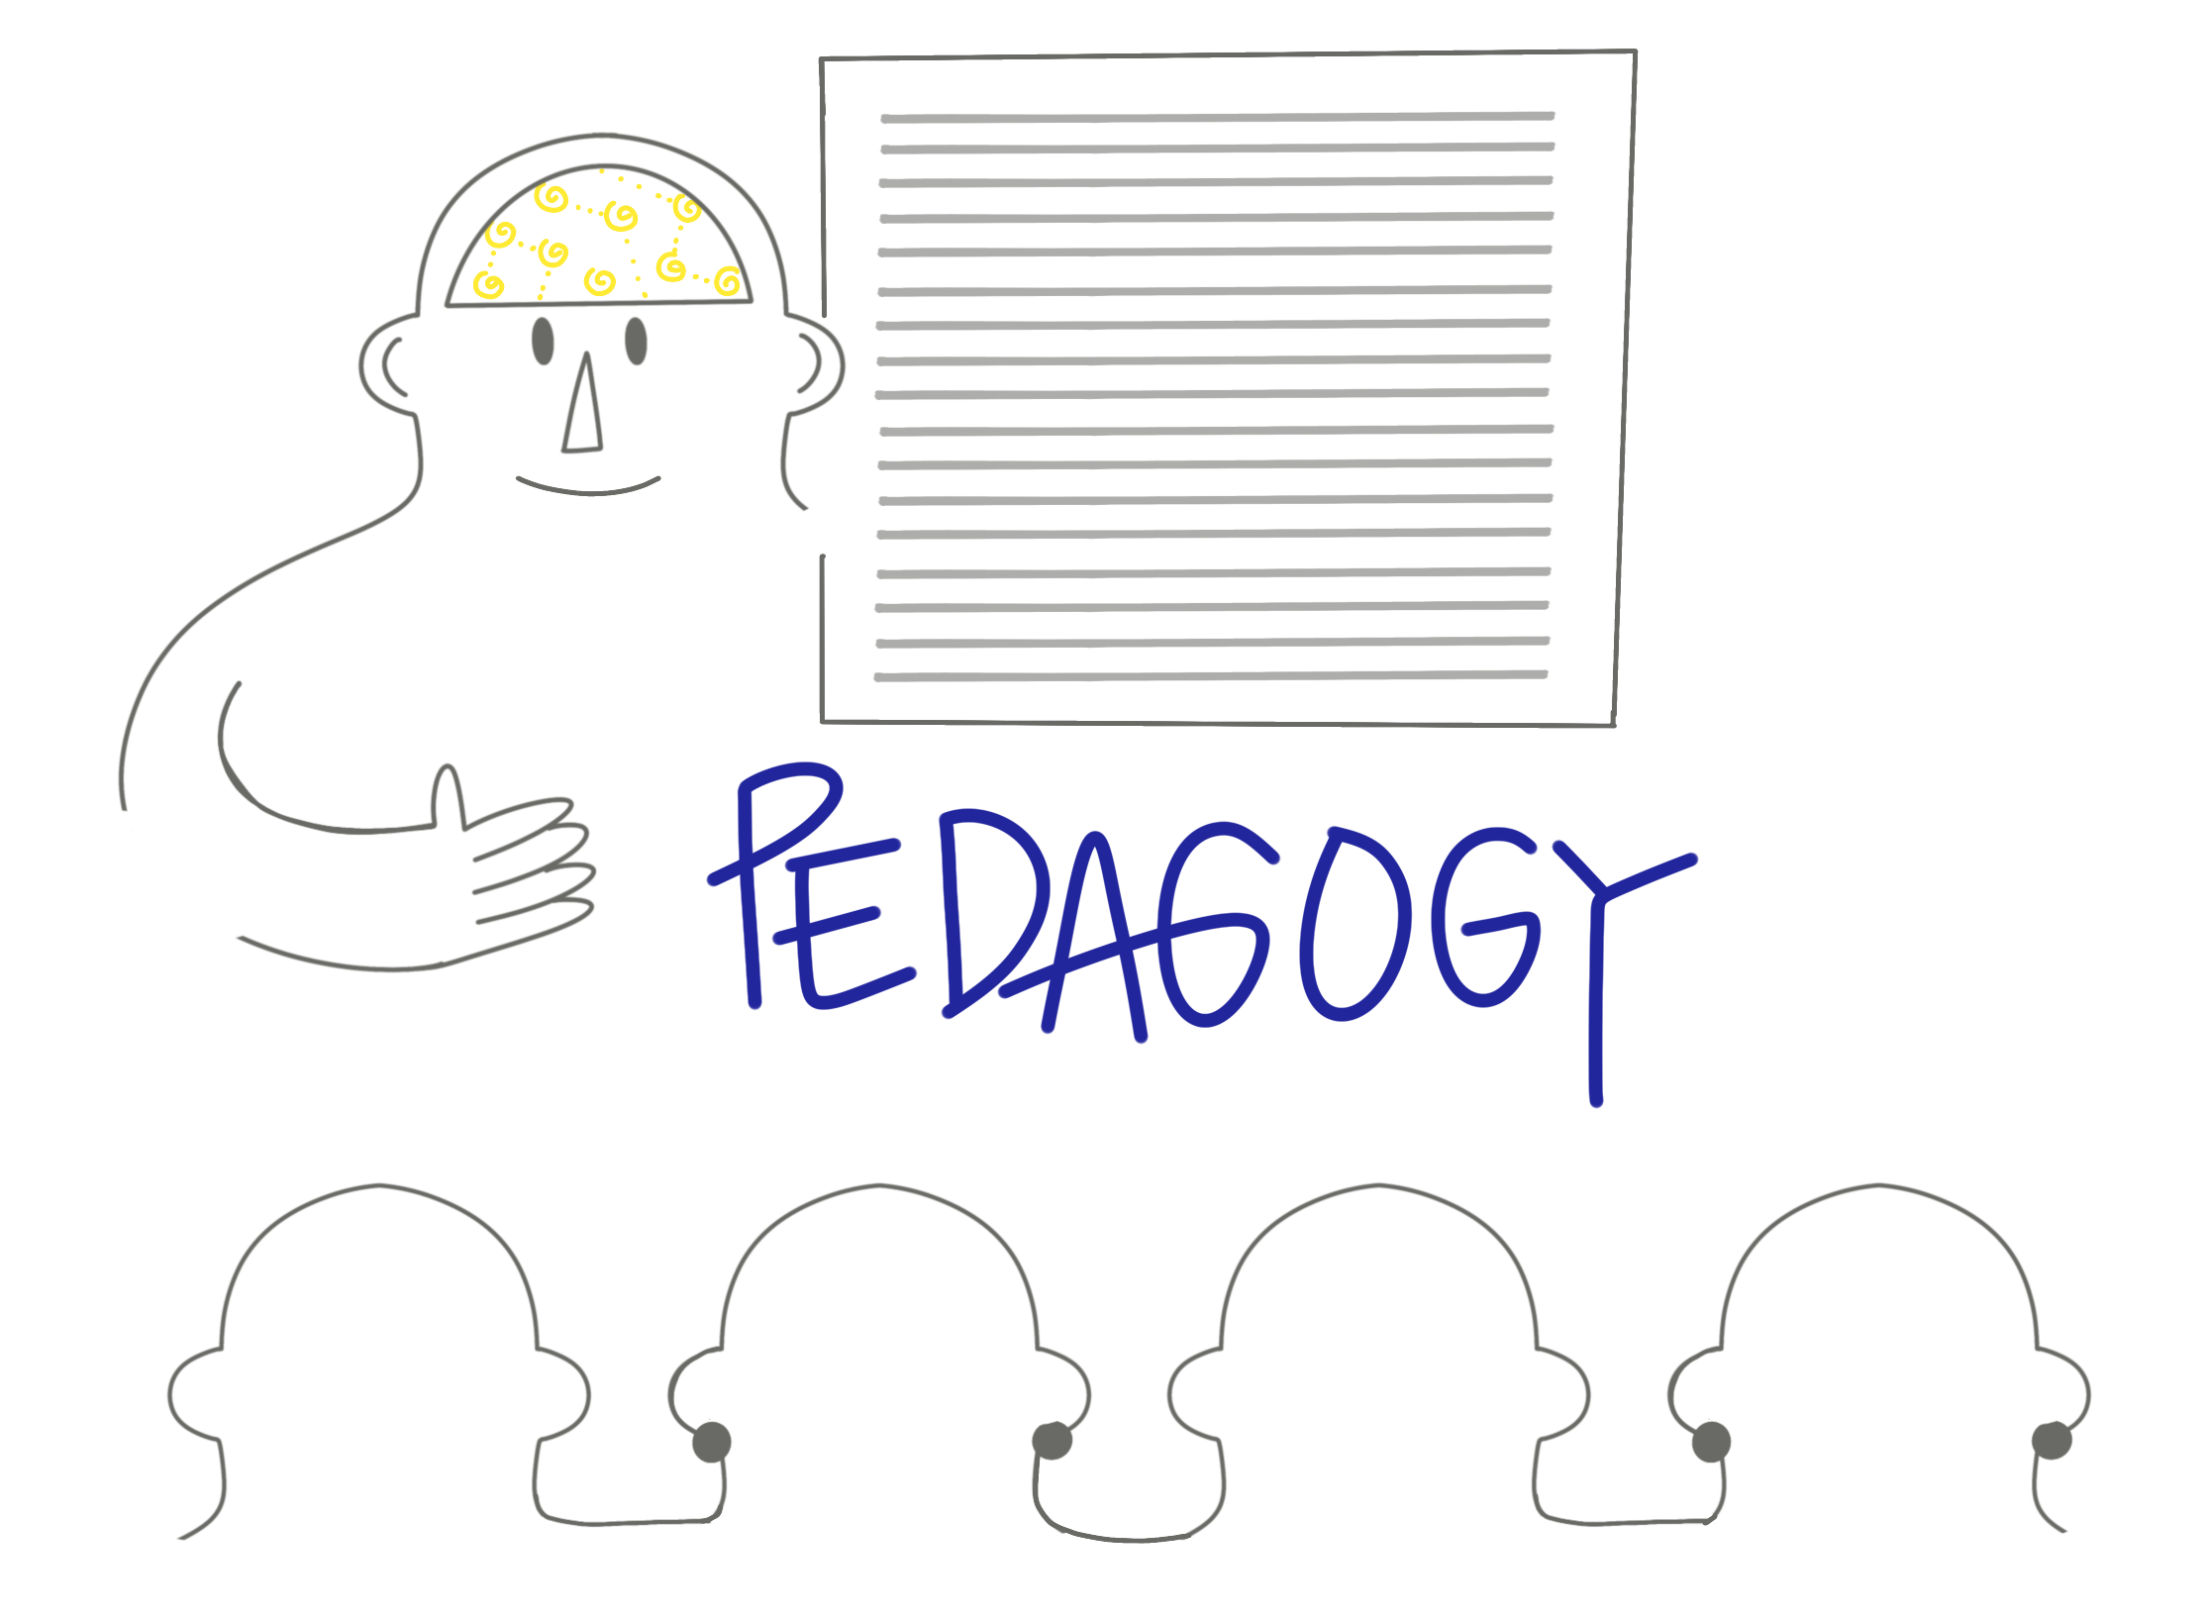
We grounded the design in teaching experience
What we did with teachers:
Interviewed teachers to explore classroom constraints and Identify recurring instructional challenges
Mapped where action feels hardest
Connected observed challenges to translate them into points of intervention
Identified where teachers could realistically act
What we intentionally did not design for:
One-size-fits-all solutions
Medicalized or deficit-framed explanations
Teachers were treated as experts in context, not recipients of training.

Slide 9
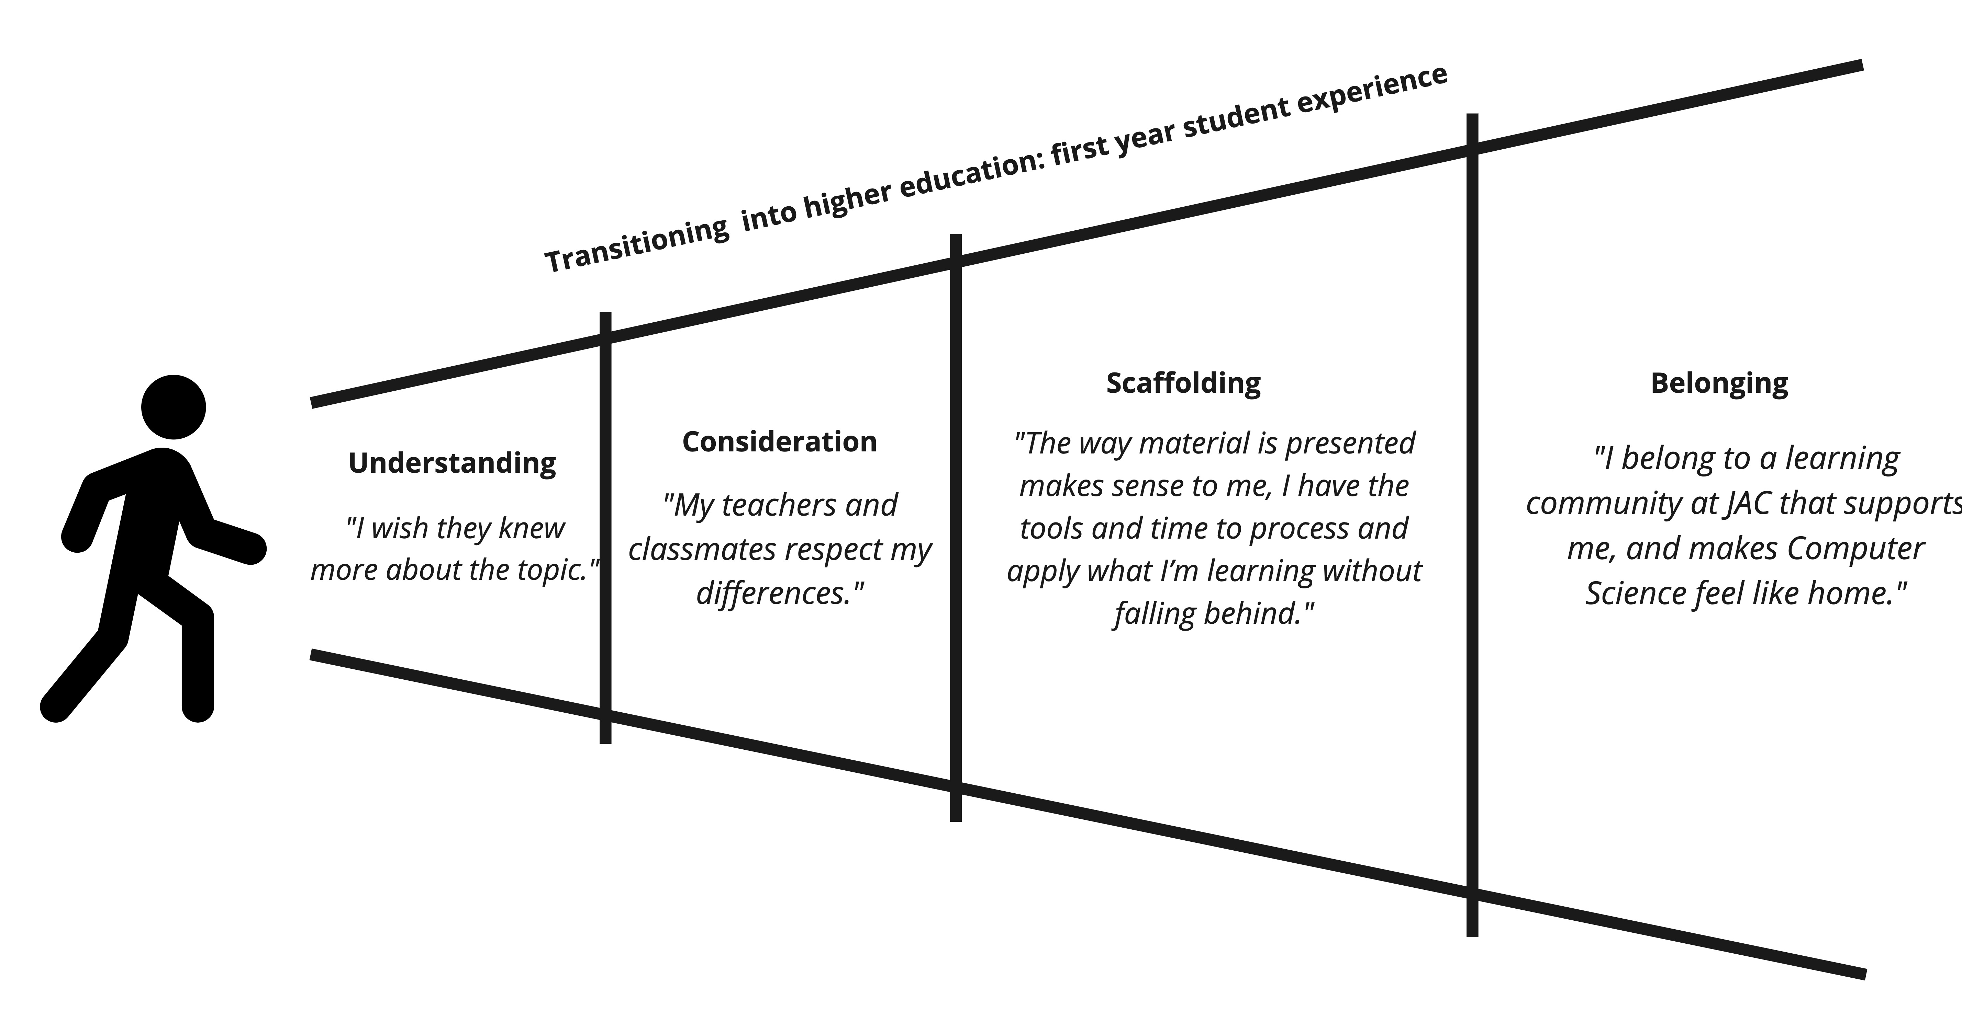
We grounded the design in student experience
What we did with the students:
Interviewed students to understand transition & classroom experience
Coded experiences and challenges
Identified recurring patterns
Identified student classroom needs

Slide 10
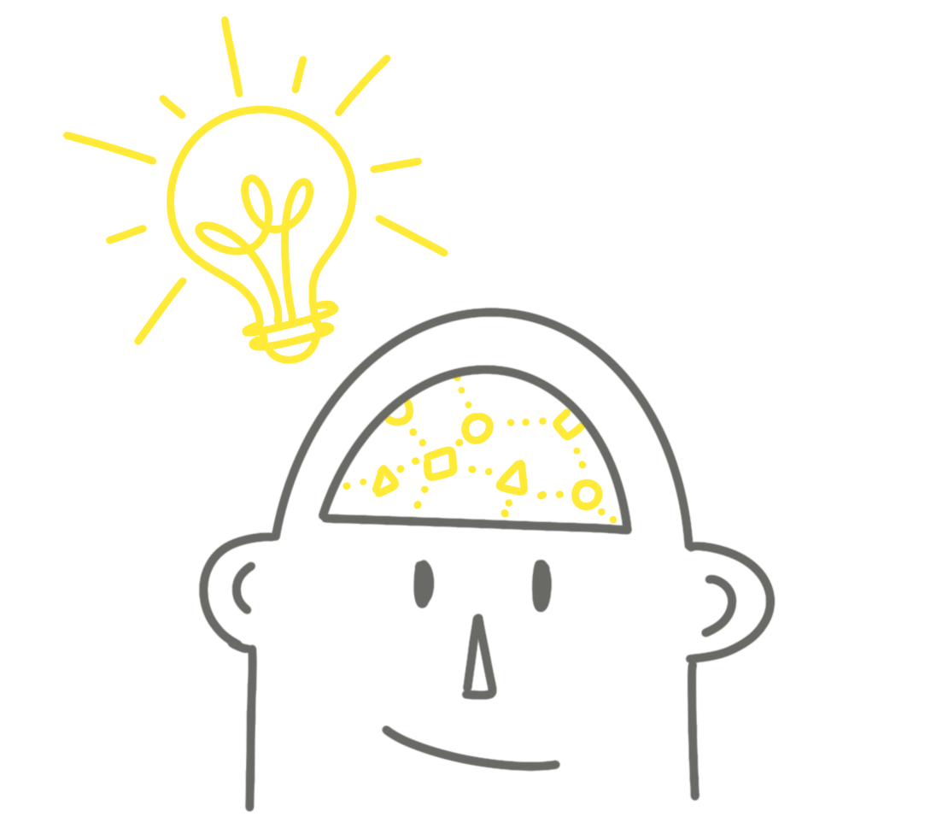
We grounded the design in Areas Needed for Learning
Research on how learning occurs: including ND mental load, UDL, and instructional design principles
Executive Functioning &
Goal Achievement
Sensory Processing & Environmental Harmony
ND students often have a different way of processing environmental stimuli, which means they may be more aware of or sensitive to sounds, sights, and other distractions in a classroom. (Juvino de Araujo et al., 2022).
Executive functioning is a set of mental tools needed to achieve a goal. They include planning, working memory, impulse control, shifting attention, and monitoring actions (Stuurman, et al 2020).
Cognitive Load & Information Processing Styles
Emotional Well-Being & Mental Health
In neurodivergent brains, working memory is often wired differently, leading to a higher demand on the brain's resources for holding and processing information.
Psychological challenges often lead to lower productivity and reduced engagement with coursework (Ji et al., 2024).
Communication & Social Demands
ND express themselves more directly or have unique ways of interpreting social cues, which can be misunderstood by others as interrupting or abrasive (Wille et al., 2017).

Slide 11
We grounded the design in Neurodivergent Paradigm
Design Principle
Strength-based framing
Deficit Based | Neurodivergent Paradigm
“Fix the student” | “Support the system”
Behavior as problem | Behavior as signal
Accommodation as exception | Design as baseline
Notes:
The goal was not to change who teachers are but to expand what feels possible in the classroom.

Slide 12
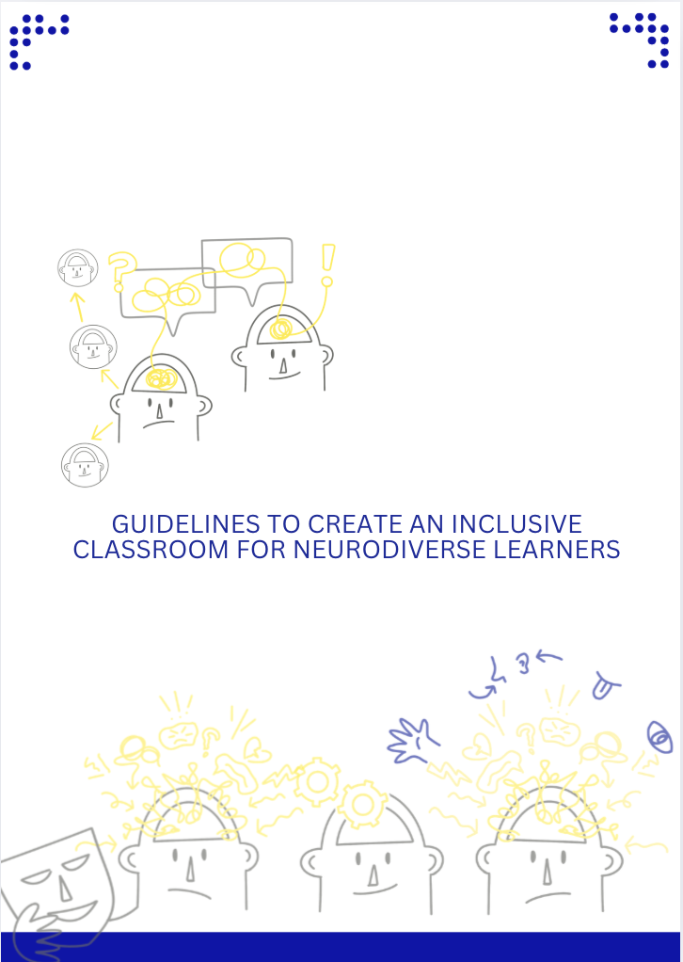
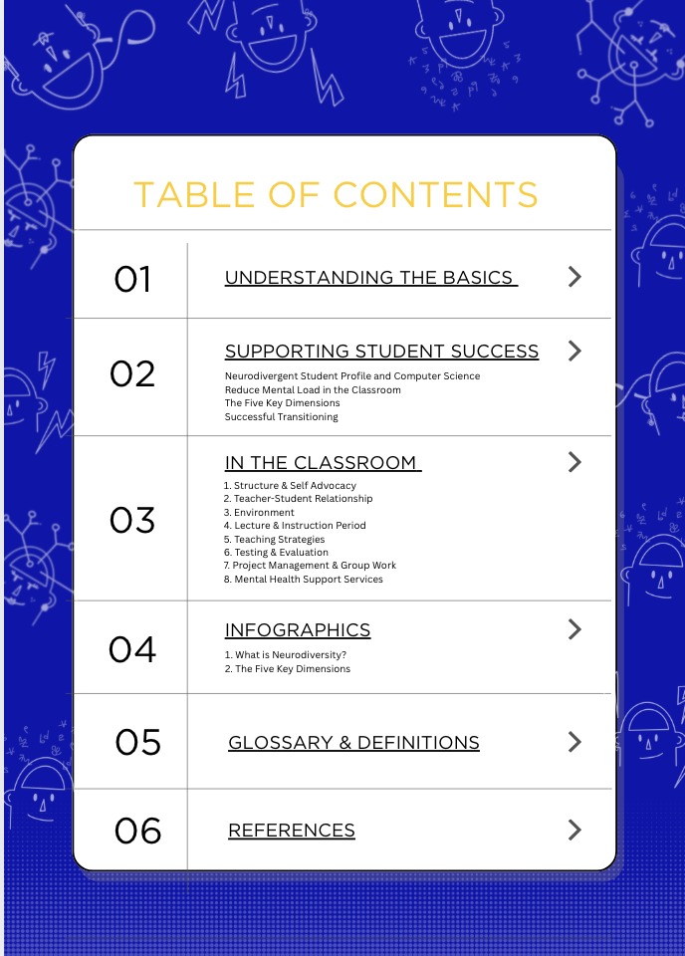
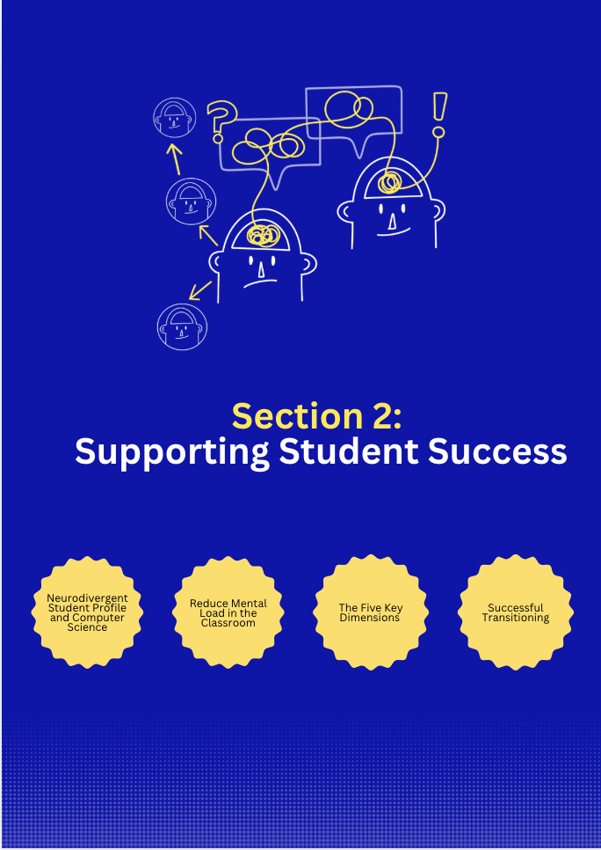
What was created
What is Neurodiversity
Supporting Student Success
and Transitioning
Classroom Strategies
Glossary & Definitions
Over 60 pages
Teacher Resource
e-book
Notes:
Strategies were selected and positioned based on classroom moments and mental load, not as generic best practices.

Slide 13
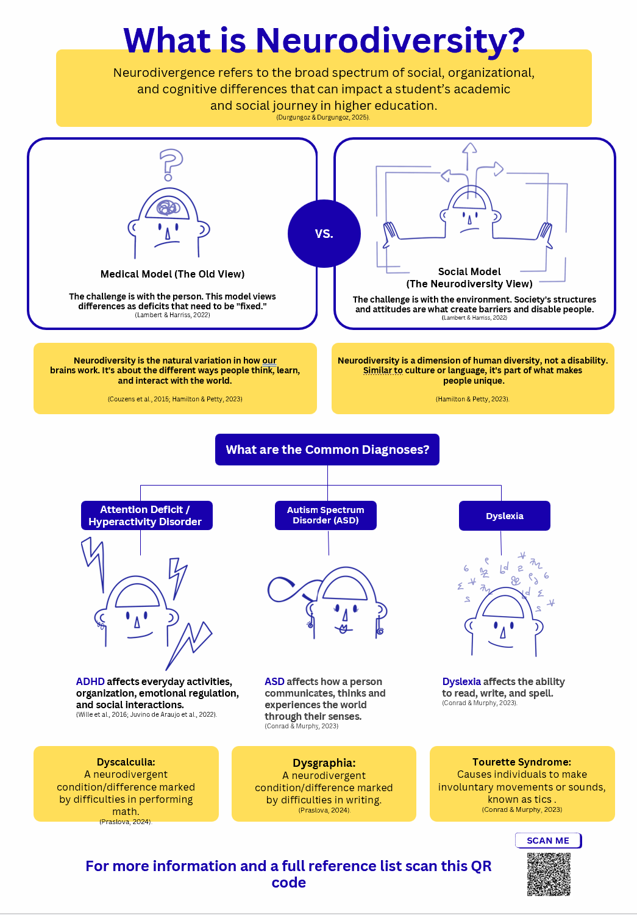

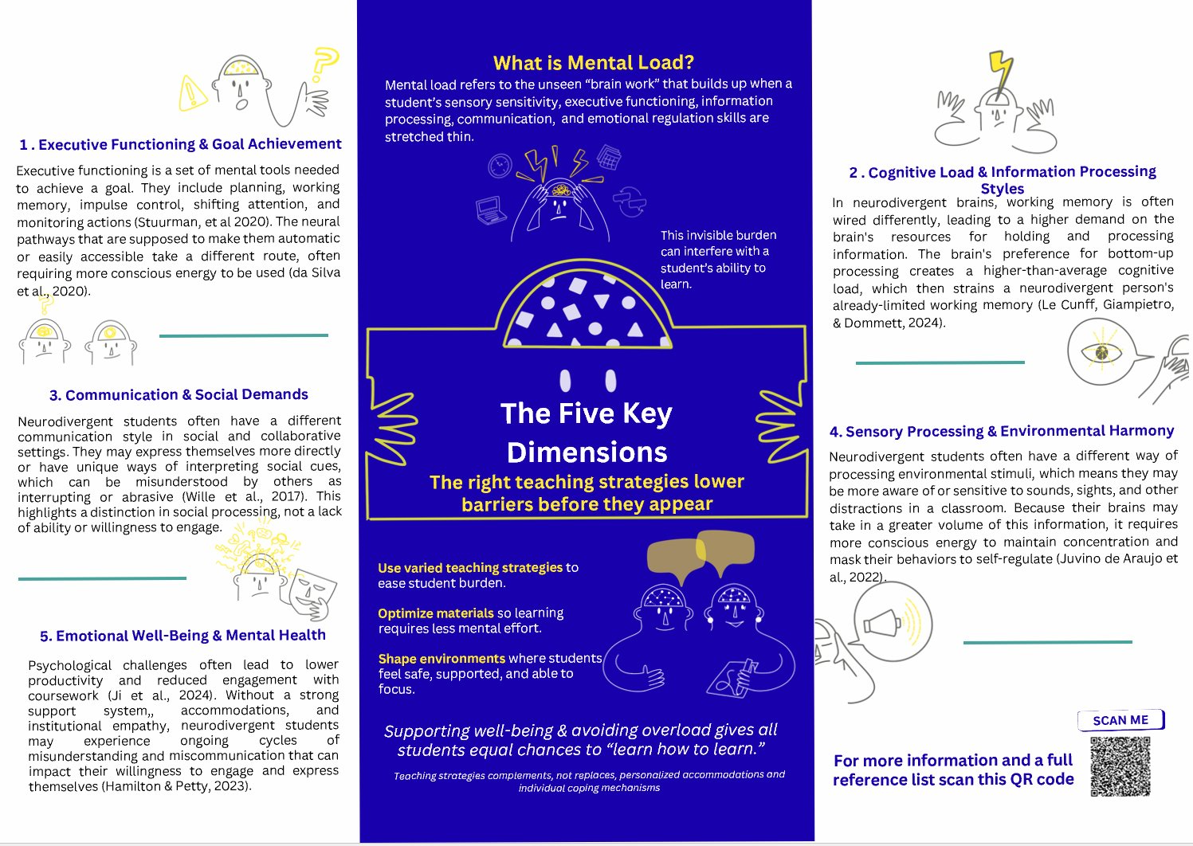
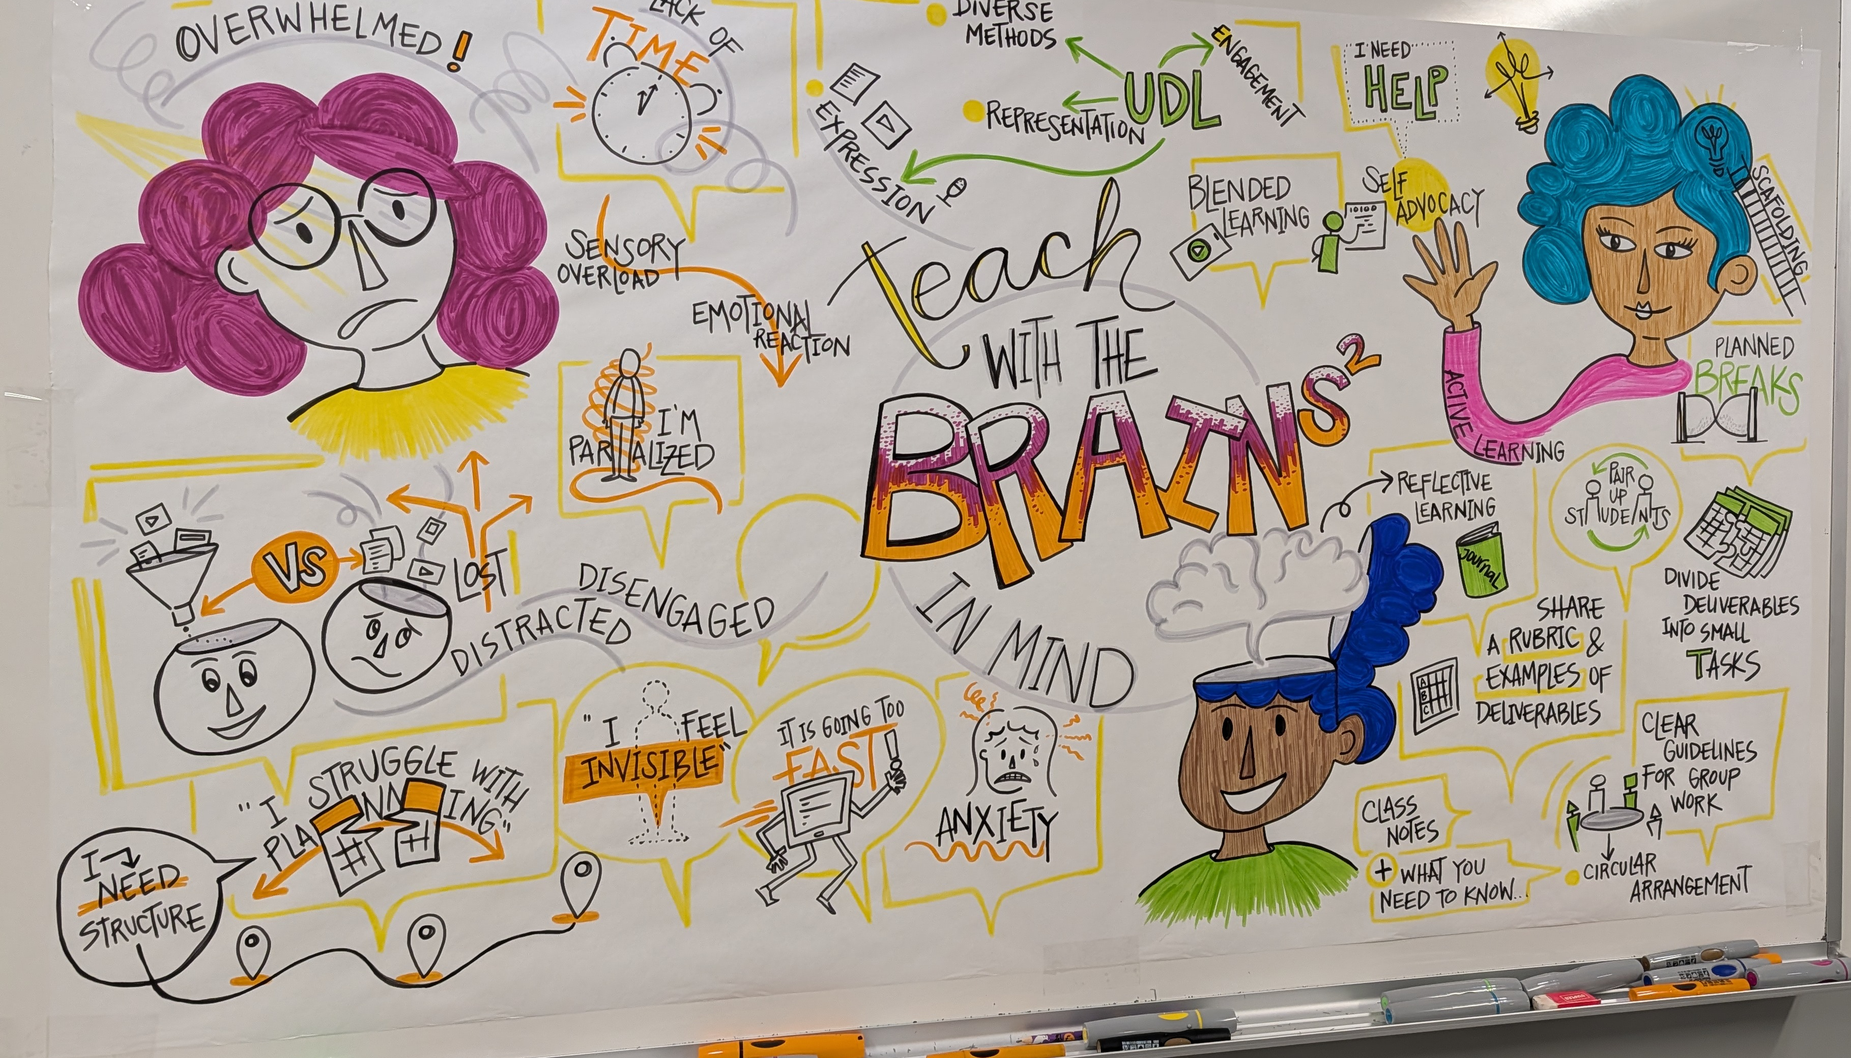
What was created
What is neurodivergent video
Infographics Posters & flyer
Commitment Postcards
Workshop Experience Poster:
Visual Note taker
Communication Pieces

Slide 14
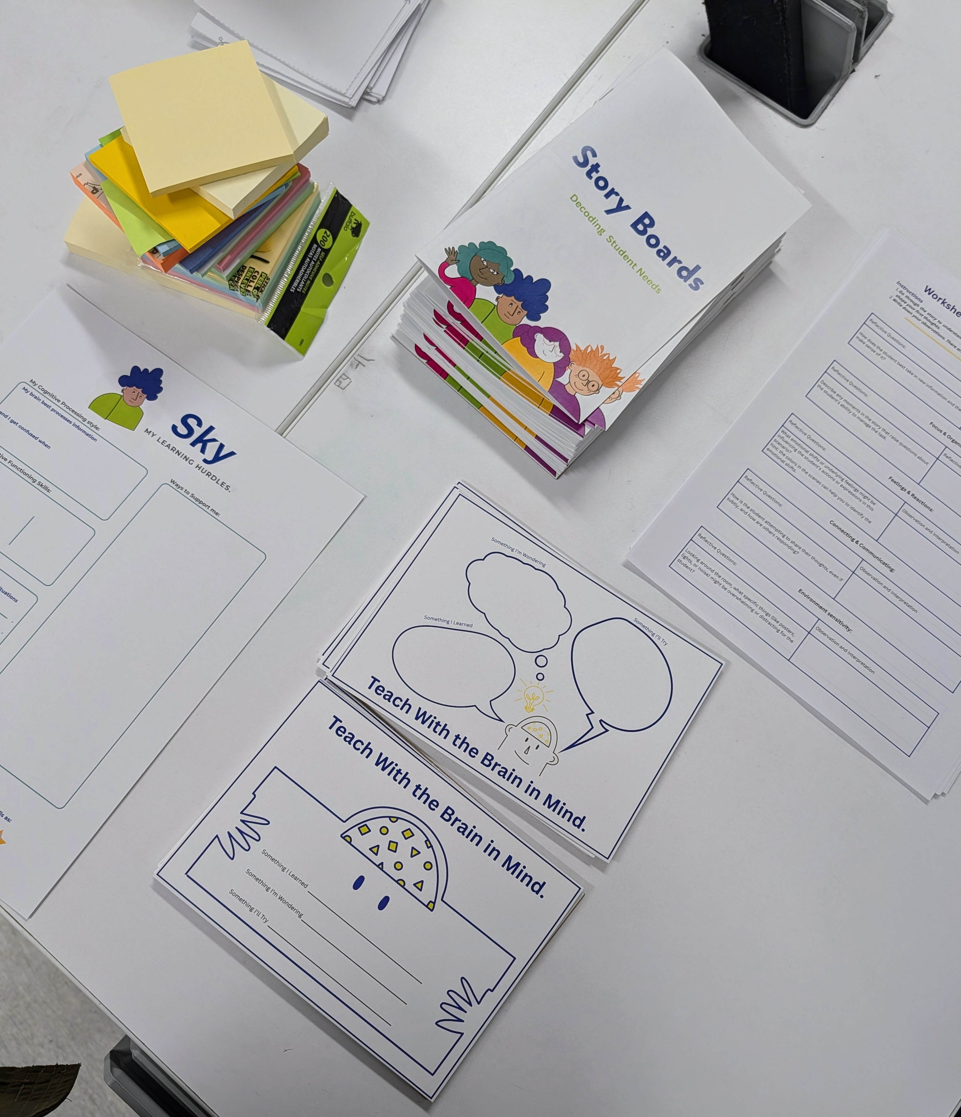
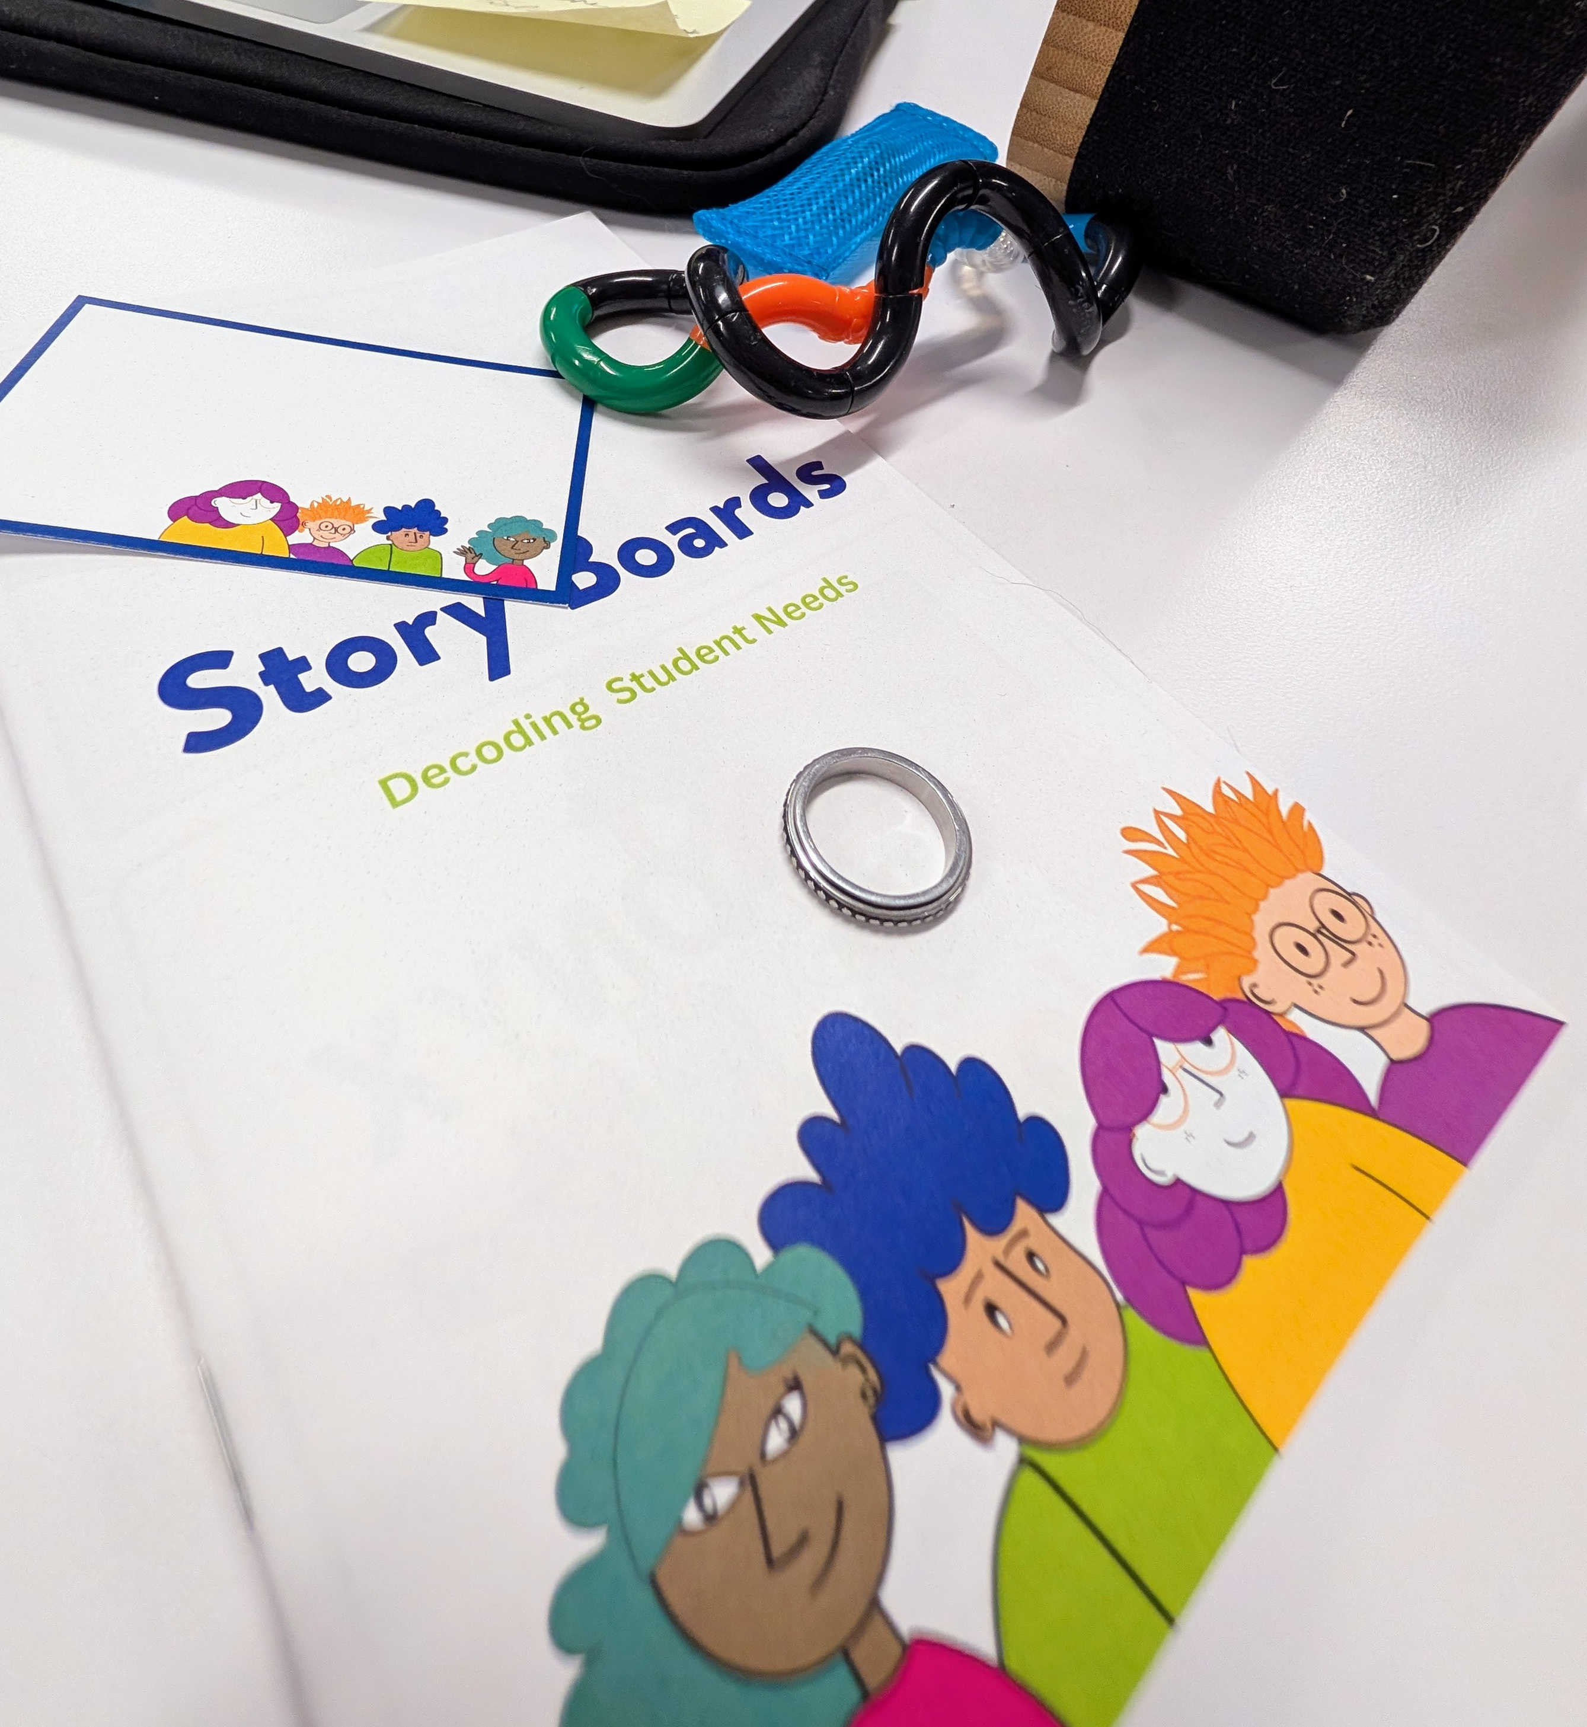
What was created
Neurodiversity Awareness Workshop
4 Learning Modules
4 Illustrated Scenerio
Worksheets
Answers Keys
Kahoot quiz for
self ssessment
Faciitator instructions
Over 50 pages in the ebook
Notes:
The DBR process itself functioned as an intervention and a scaffolding space for educators, where knowledge evolved through dialogue.

Slide 15
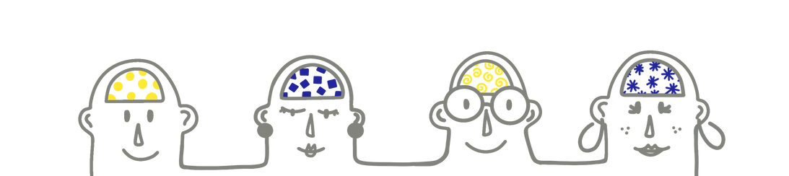
Teach With the Brains in Mind

Slide 16
Objectives
  Recognizing neurodivergent cues
  Selecting strategies to create inclusive classrooms
Modules
Learning Insights Module
Support Module
1
2
3
4
Identifying Cues Module
Empathy Experience Module

Slide 17
Learning Insights Module

Slide 18
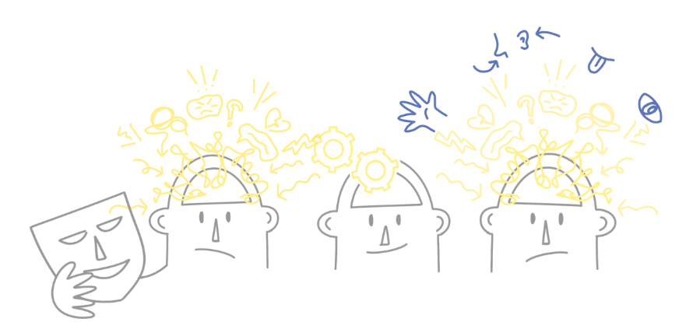
What is Neurodiversity?

Slide 19
Identifying Cues Module

Slide 20
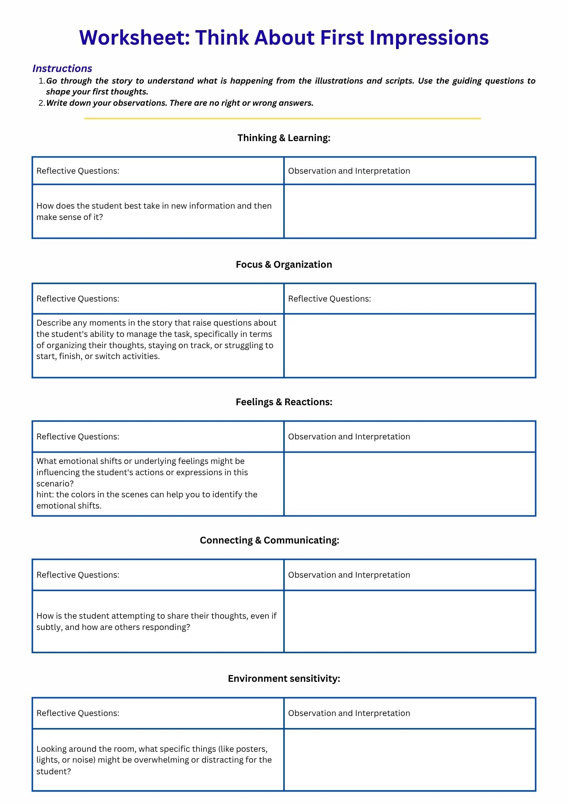



Think
Instructions
Read the entire story of the student assigned to you. Let the visuals and words give you a general sense of what's happening.
Complete the Think About First Impressions Worksheet. We have provided some prompt questions to help direct your initial thoughts. Connect it to your own experience.
Remember: There is no right or wrong answer. These are your impressions of the scenario.
10 mins

Slide 21
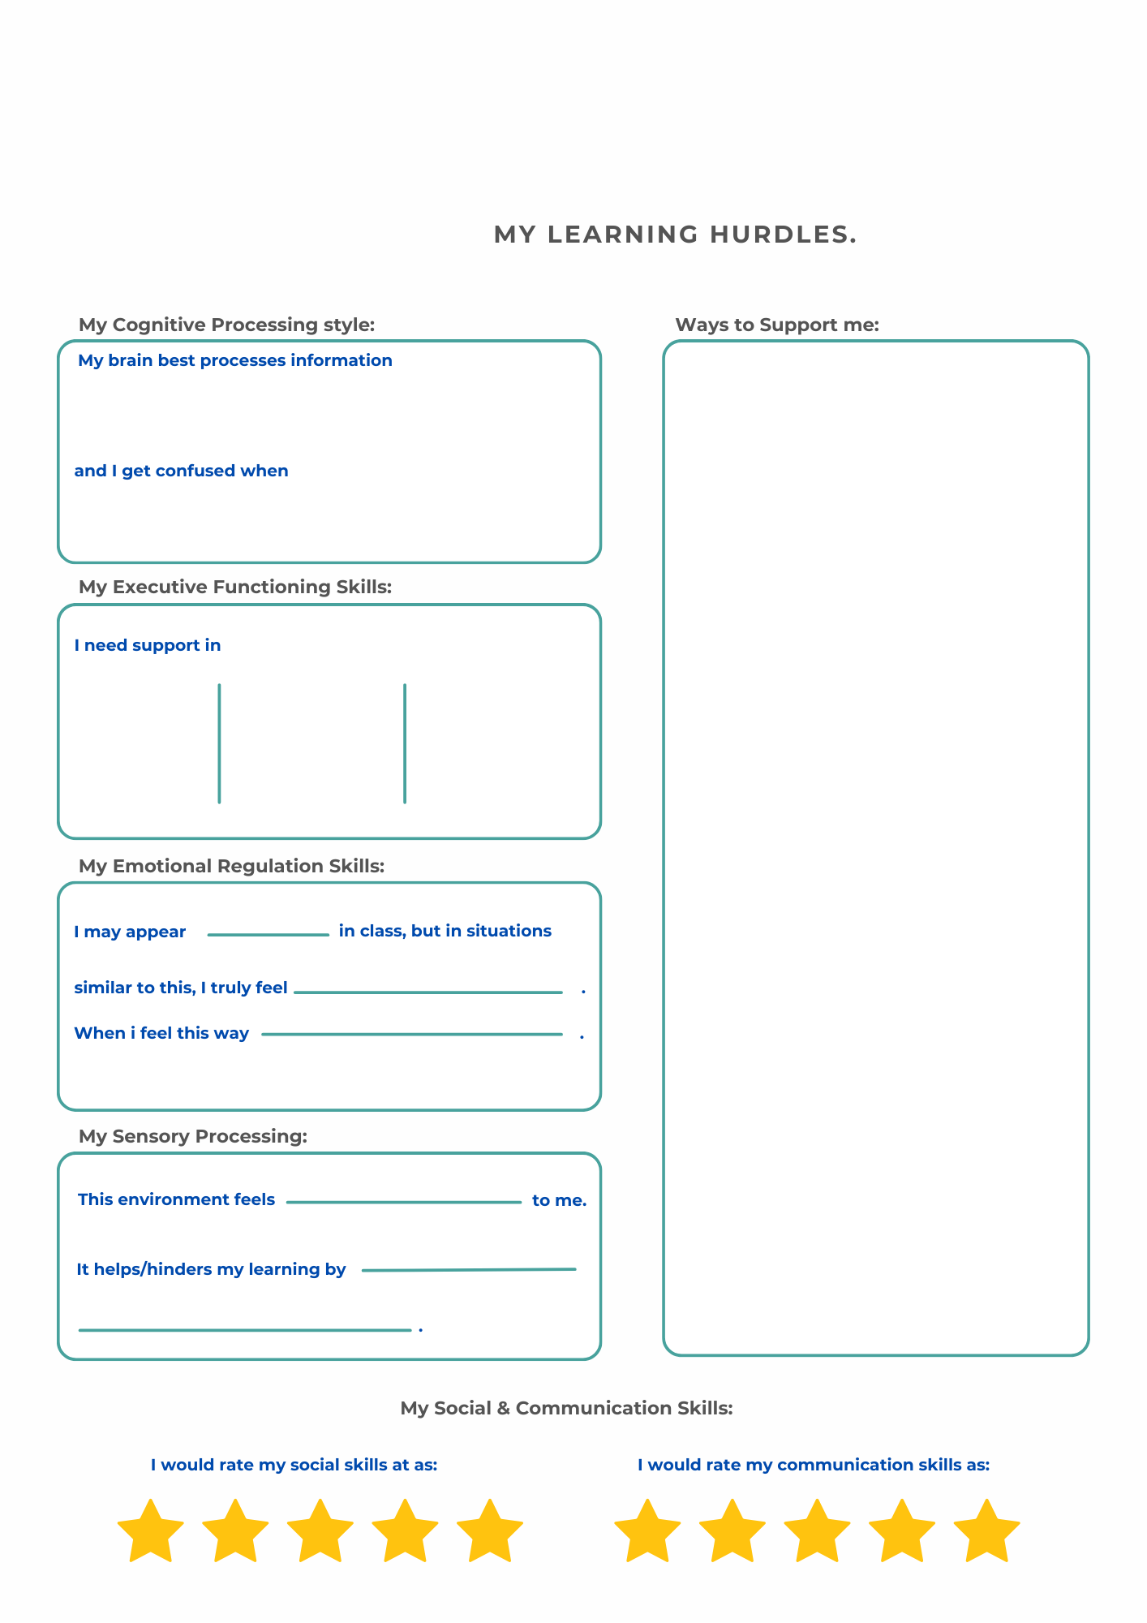
Group
Instructions
  Join others working on the same profile as you.
  Choose one person to be the profile presenter.
  Discuss your first impressions of the student's story.
  Merge your worksheets to complete the student profile.
10
mins

Slide 22
Share
Instructions
  The presenter of every group has 2 minutes to
    tell the story
    present their student profile.
15 mins

Slide 23

Support Module
Notes:
Before we dive into the workshop and resources we created I want to take a moment to explain why this work is important.

Slide 24
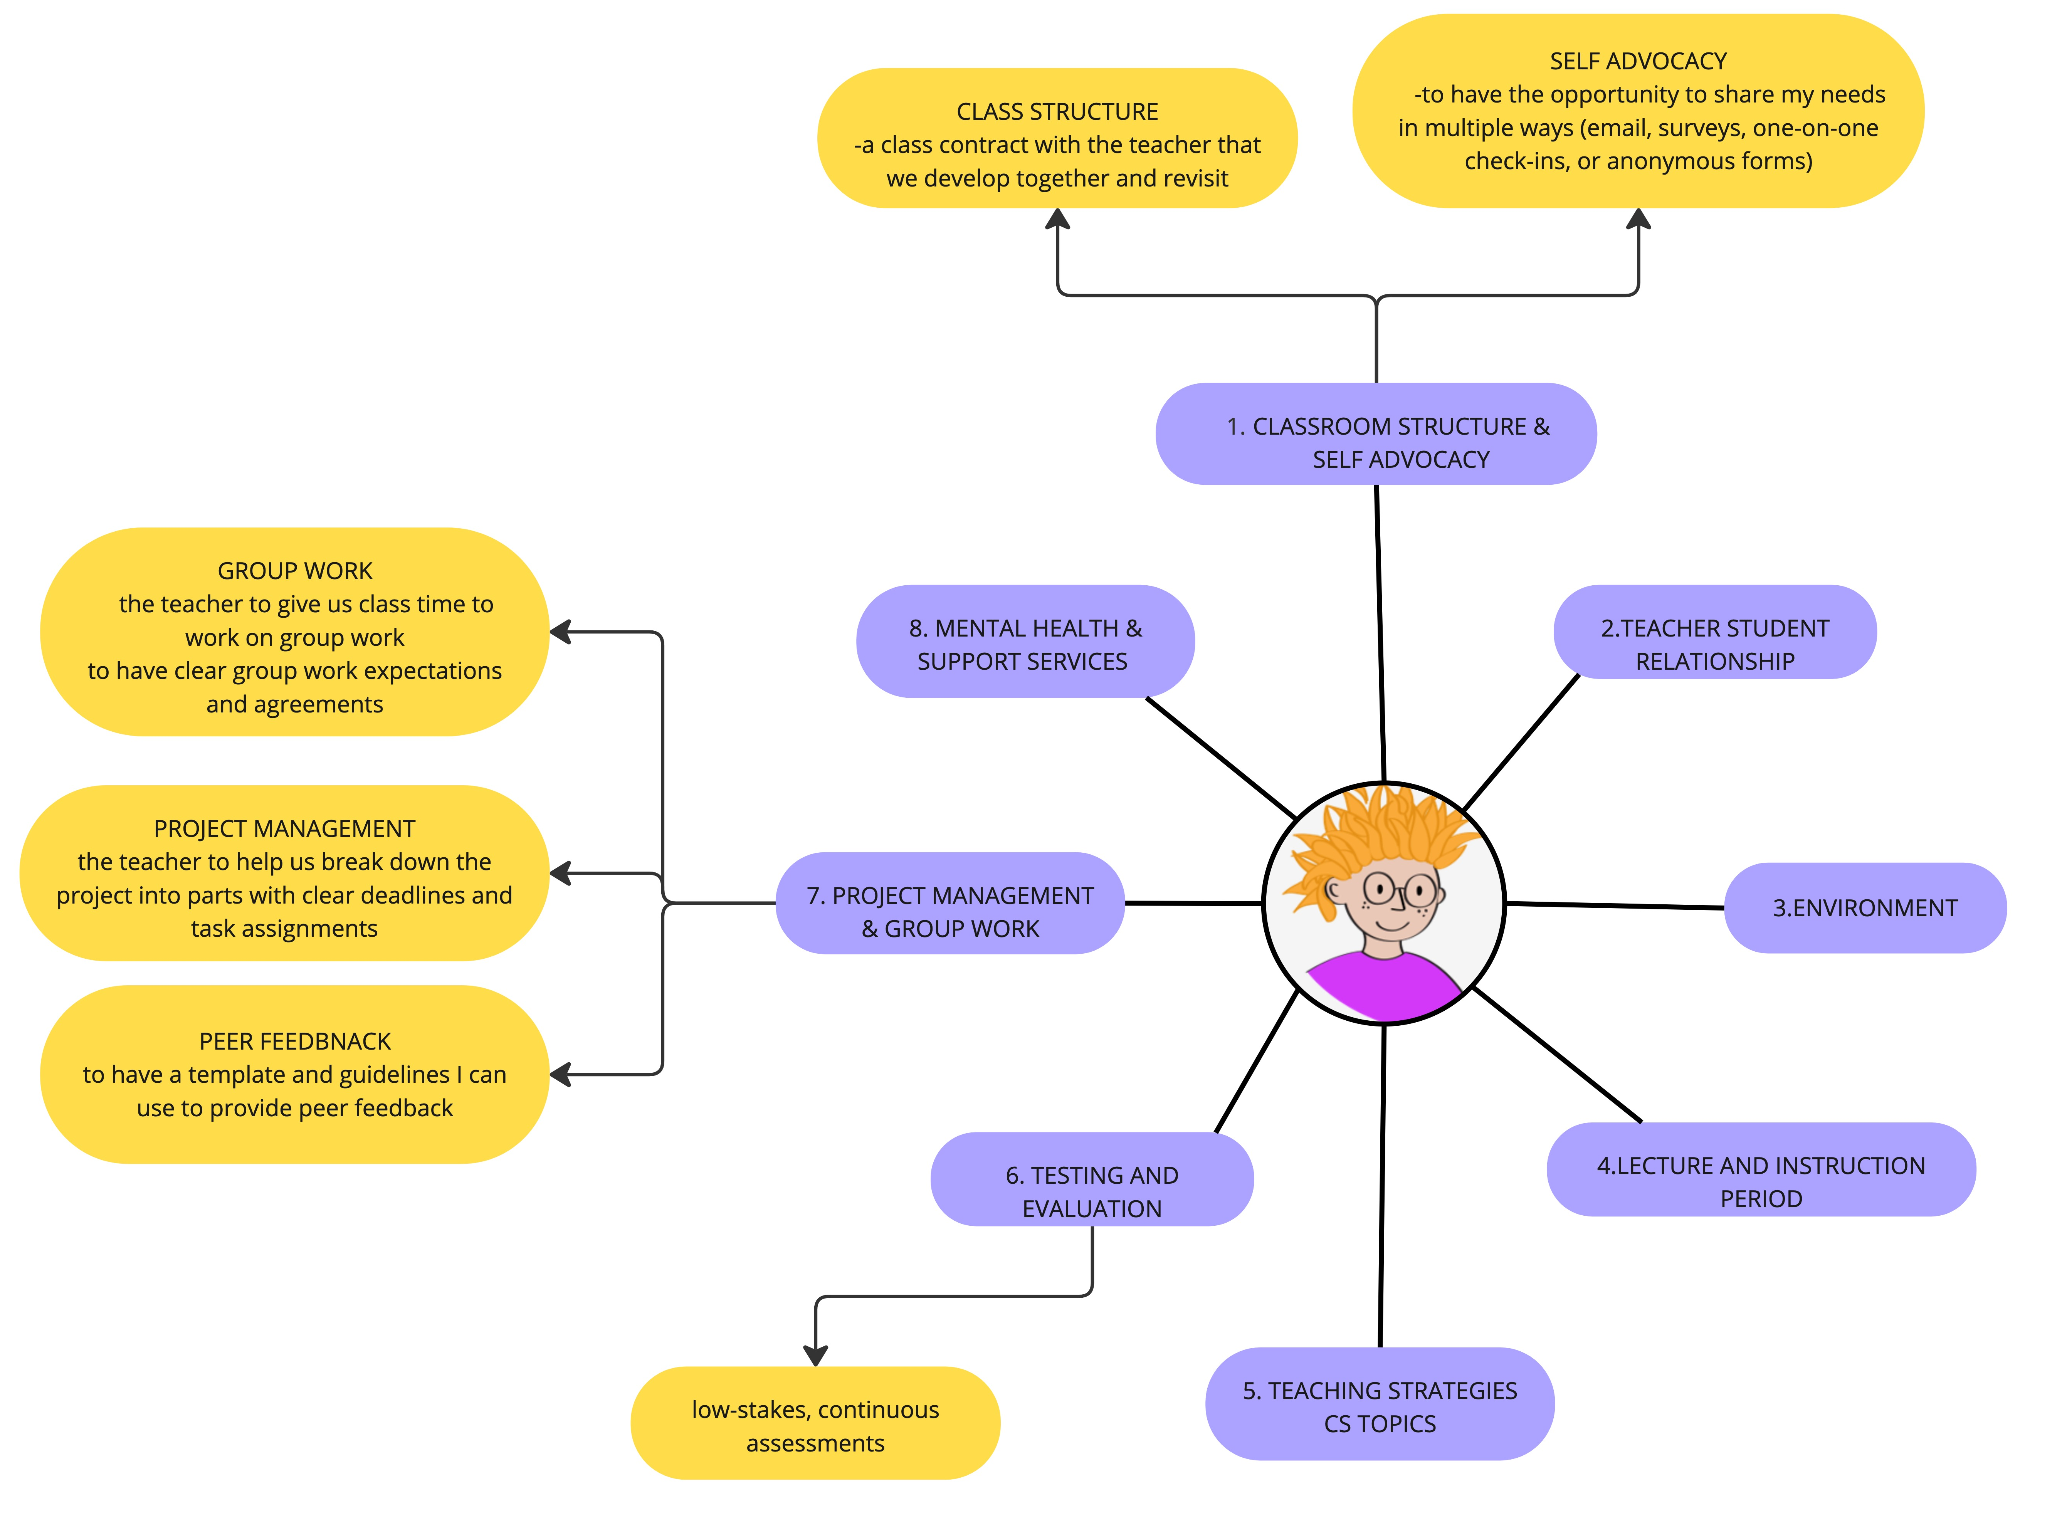
SUPPPORT
The Strategies were selected and positioned based on classroom moments and mental load, not as generic best practices.
Example: Jo's experience
Work tasks that relies
heavily on:
Executive Functioning
Communication & Social

Slide 25
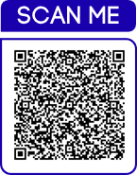
Questions
  What we created

Slide 26

"Do the best you can until you know better. Then when you know better, do better.”
― Maya Angelou
Notes:
A holistic approach where mental health and learning needs of all students are met, will foster better academic outcomes, improve student well-being, and promote a more positive learning experience.

