Slide 1
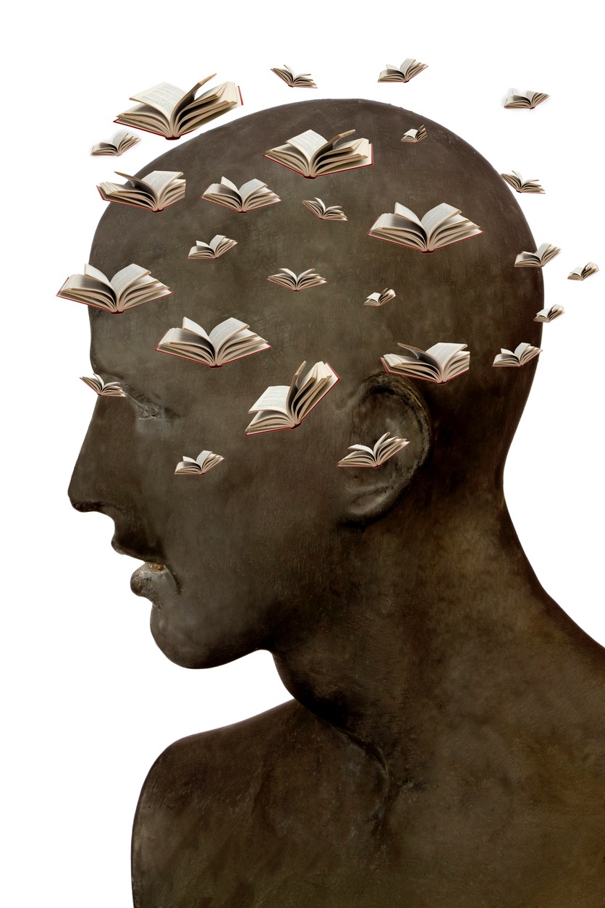
Évolution de la métacognition de trois étudiants du niveau collégial présentant un trouble du spectre de l’autisme
istockphoto.com.

Slide 2
istockphoto.com.

Slide 3
istockphoto.com.

Slide 4
istockphoto.com.

Slide 5
istockphoto.com.

Slide 6
istockphoto.com.

Slide 7
istockphoto.com.

Slide 8
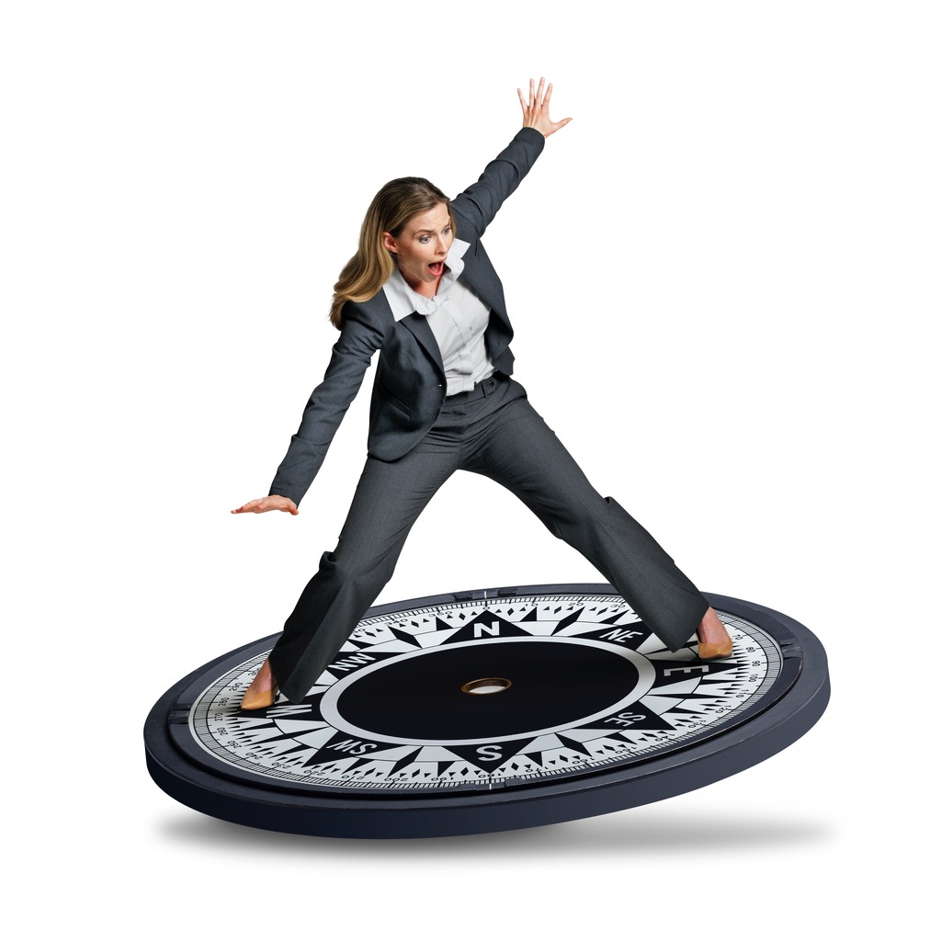
istockphoto.com.

Slide 9
istockphoto.com.

Slide 10
istockphoto.com.

Slide 11
istockphoto.com.

Slide 12
istockphoto.com.

Slide 13
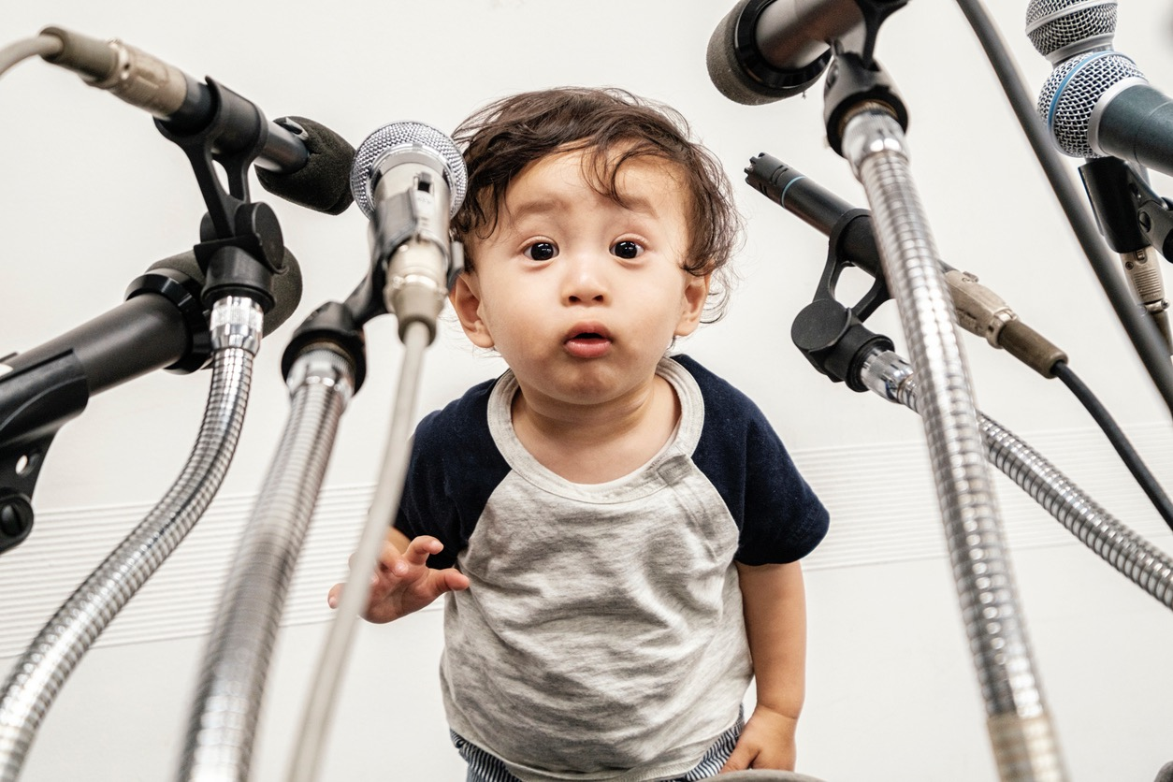
istockphoto.com.

Slide 14
istockphoto.com.

Slide 15
istockphoto.com.

Slide 16
istockphoto.com.

Slide 17
COLLABORATION
istockphoto.com.

Slide 18
istockphoto.com.

Slide 19
istockphoto.com.

Slide 20
Mildred Dorismond mdorismo@cvm.qc.ca
istockphoto.com.

